Slide 1
“Our vision is to be recognised as a vibrant and respected tennis club encouraging participation in tennis welcoming all age groups and abilities”
STRATEGIC PLAN
2017-2020

Slide 2
OUR MISSION:
THE YUNGABURRA TENNIS CLUB IS FOCUSED ON PROVIDING A WELCOMING ENVIRONMENT.
FOR ITS MEMBERS AND GUESTS TO PARTICIPATE IN TENNIS, FITNESS AND SOCIAL ACTIVITIES.
WE ARE FOCUSED ON OPTIMISING OUR FACILITIES TO DELIVER SUSTAINABLE MEMBER VALUE AND MEMBERSHIP GROWTH.
WE VALUE OUR HISTORY AND ARE FORWARD THINKING AND AMBITIOUS IN OUR OUTLOOK.
WE VALUE THE FAMILY UNIT. FAMILIES THAT PLAY TOGETHER, STAY TOGETHER.

Slide 3
Dear Members
To build on the strengths and directions of successive Club Committees, and over past years of the club’s continuous service to the Yungaburra community, a strategic review of the Yungaburra Tennis Club has been undertaken. The outcome of this review was the development of the Yungaburra Tennis Club Strategic Plan 2017-2020.
The Plan was developed by an four-member Strategic Planning Committee, who with the guidance of a consultant, reviewed and analysed the club’s operations, researched trends within the tennis and broader sporting industry, met with midweek and full playing members, and ran a series of focus groups. The committee received many submissions from members and actively sought the input of key stakeholders, including Tennis Qld and Tableland Regional Council.
The review found the cost of maintaining synthetic grass tennis courts to the standard required is sustainable under the current business model. It also found club infrastructure could be improved, through the introduction of more flexible and more durable facilities. The review also identified opportunities to increase revenue by making our club more accessible to a broader range of users.
Another finding was that club membership is no longer as representative of the local community as it used to be. Yungaburra has changed significantly in the last decade and will continue to change. Census data shows the fastest growing groups within our community are adults in the 35-49 year old age group and their children, as well as seniors. These age groups are under represented in our current membership.
Tableland Regional Council identified tennis as one of the most popular sporting past-times in Yungaburra, second only to walking. Other research found that the vast majority of people who want to play tennis do not necessarily want to become members of tennis clubs or take part in regular competition. These players are a potential source of revenue for the club that should not be overlooked.
Of course, one of the main findings of the review was that high quality social and competitive tennis on synthetic tennis courts is a very important part of the Yungaburra Tennis Club culture. The Strategic Plan ensures this is preserved and that it is in fact further developed.
As a partner to the plan we thank you for your participation in its development and look forward to your continued support during its implementation.
President
Vicki Chatfield

Slide 4
THE KEY AREAS:
TENNIS
MEMBERSHIP
COMMUNICATIONS and MARKETING
SAFETY
INFRASTRUCTURE
FINANCE and ADMINISTRATION

Slide 5
TENNIS
Our Goals Strategies and Actions
Tennis Program - Provide enjoyable social and competitive
club programs.
Annually review the tennis program and communicate key events in the tennis calendar in a timely manner.
Player Development - Provide pathways for players to reach their
full potential. Engage a professional coach or coaches based on member demand & the needs of the different playing groups.
Reciprocal Tennis - Enhance member opportunities to play at local, regional clubs. Travel to Mareeba to engage in social competitions.

Slide 6
MEMBERSHIP
Our Goals Strategies and Actions
Membership –
increase by 25% by 2018. Continually recruit new members.
Implement free ‘come and try it' experiences for our social tennis windows.
Review clothing rules to ensure they reflect current and future membership expectations.
Membership -
reflects the age diversity in our community. Assess the feasibility of program offerings for
under 12 year olds.
Encourage access to Junior Memberships
when Youth Members attain required playing standard. Maybe look into offering childminding services to increase access for parents and carers.
Seek opportunities to engage families.

Slide 7
COMMUNICATION and MARKETING
Our Goals Strategies and Actions
Internal communications -
Actively engage with members and potential members. Email regular newsletters and keep website up to date.
Develop appropriate social media channels.
Look at possible publishing of an annual yearbook for members.
Marketing initiatives -
Develop a range of initiatives that target
specific groups within the community. Review club branding, logo and clothing to ensure
it is contemporary and attractive.
Develop strategic alliances with other community
groups and local businesses.
Use various marketing initiatives including Open Days, media release templates, and attendance at local community events.
Marketing initiatives -
Encourage members to promote the club
to their networks. Develop an ongoing campaign to encourage members
to bring guests.
Enhance awareness of facilities -
Increase frequency of member and community
initiated functions and diversify revenue streams. Market availability of clubhouse for regular and one-off hires.
Promote Corporate Tennis Days.

Slide 8
SAFETY
Our Goals Strategies and Actions
Compliance -
Ensure club meets all legislative requirements Review club's compliance with OHS and WHS
legislation and guidelines.
INFRASTRUCTURE
Our Goals
Strategies and Actions
Courts -
Provide well maintained courts that provide an
exceptionable experience in a relaxed tennis environment. Develop a court master plan in conjunction with our committee improve playing surface,
document annual maintenance tasks and ensure
ongoing member enjoyment.
Clubhouse -
Provide a welcoming, well presented, safe and
comfortable clubhouse, incorporating appropriate
members' facilities. Develop a clubhouse and grounds' master plan to implement improvement and consider alternative
options for increased revenue.
Clubhouse precinct -
Improve presentation of club's entry area
and players' shed. Make improvements to provide a welcoming
entry area and improved player's shed.
Assess viability of flagpole and assess wether to renovate or replace.

Slide 9
FINANCE and ADMINISTRATION
Our Goals Strategies and Actions
Finance -
Ensure ongoing financial sustainability of the club. Review business practices and financial management processes.
Diversify income streams to reduce reliance on membership fees.
Finance -
Ensure adequate funds are available for capital
and operating costs. Develop a budgeting process covering all operations of the club.
Membership fees -
Ensure they are attractive and equitable. Move toward a more equitable fee structure.
Governance -
Ensure Articles of Association are relevant. Review Articles of Association to ensure they are consistent with current and future directions.
Strategy -
Develop and implement succession planning in all roles. Identify succession plans.
Strategy -
Sound strategic planning principles underpin
all club activities. Include Strategic Planning in every
every monthly committee meeting agenda.

Slide 10
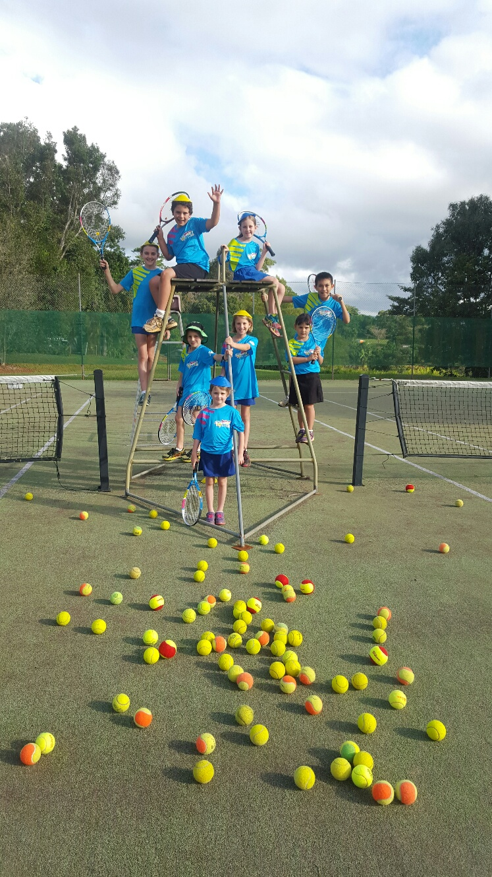
YUNGABURRA TENNIS CLUB Memorial Park Yungaburra Qld 4884 Australia yungaburratc@gmail.com www.tennis.com.au/yungaburra  Like us on Facebook

