Slide 1

Tennis Club Name
Sponsorship Proposal

Slide 2
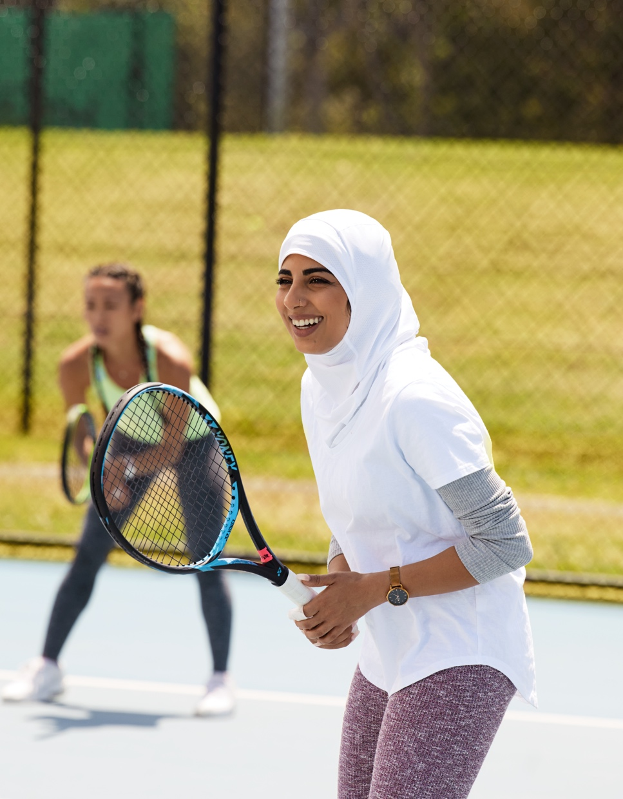
About us
[The below text is editable and should be changed to suit your needs]
The [Insert your club name here] is located in [Insert location] and has been in operation since [Insert date here] .
[Insert your club name here] is a membership based club with competitions both day and night, midweek and weekend. There is a strong social component to the club and members have access to BBQ facilities, a fully licensed bar, kitchen and new amenities such as a lounge area and plasma television. The club also have a function room for hire which caters for birthdays, receptions and conferences.
For more information about our club please find us at [Insert your club contact details here].

Slide 3


Slide 4

We have an ambition to create a club that is welcoming for all people, young and old, families or new people to the neighbourhood; and bring them together through a mutual love of tennis.
We believe [their business] would be a perfect fit to join us on this ambition.

Slide 5
Some of what we can offer
OPEN COURT SESSIONS
Get loud at Open Court Sessions. At 90-minutes long, embrace fresh and fun new tennis activities, enjoy drinks and food and get boppy with a killer playlist.
Demographic: all genders aged between 25 and 45 (any ability level)
CARDIO TENNIS
Bringing together a variety of cardio workouts and a range of fun tennis drills, Cardio Tennis is all about quick fitness and great tunes.
Demographic: all genders aged between 35 and 50 (any ability level)
ANZ TENNIS HOT SHOTS
Tennis for kids! It’s a program designed to help every child, no matter their age or ability, to jump in and start playing tennis.
Demographic: Children aged 5 to 12 – their families become active within the club.
COMPETITIONS AND TOURNMENTS
Multiple nights a week, we run social tournaments for players of intermediate skill and above. Interclub tournaments on the weekend also see players from other clubs visiting our venue.
Demographic: all genders aged between 18 and 40 (intermediate level and above)
COURT HIRE
People come from all over to have a casual hit at our courts. Every person and any player is welcome at our club to pick up a tennis racquet and play.
SOCIAL NIGHTS AND EVENTS
We run social event every term for all our families, players and customers. Sometimes we run fun social tennis events and other times we run events like trivia nights or family days.

Slide 6
Sponsorship Options
ACE SPONSORSHIP
Naming rights to an event or court
Two pull up banners with
your branding
Posters displayed in clubrooms
Two outside court signs
Product display space
during event
Prizes and trophies “brought to you by…”
Offer to tennis club customers (2x emails)
Feature on tennis club website
Four social media posts
per term
$2,500 PER 10 WEEK TERM
RALLY SPONSORSHIP
One pull up banner with
your branding
Posters displayed in
clubrooms
One outside court sign
Prizes and trophies “brought to you by…”
Offer to tennis club customers (2x emails)
Feature on tennis club website
Two social media posts
per term
$1,500 PER 10 WEEK TERM
HIT SPONSORSHIP
(event specific)
One outside court sign
Prizes and trophies “brought to you by…”
Offer to tennis club
customers (x2 emails)
Feature on tennis
club website
Two social media posts
Contra provided every week
PER 10 WEEK TERM

Slide 7
Some exciting things coming up
Outline here some exciting events/happenings or important dates coming up in your termly calendar and identify how your potential sponsor may be able to be involved.
Open Day? Allow them a space to activate their business.
New ladies morning event? Give these customers a specific benefit for attending the ladies mornings.
Raffle or fundraising night? Offer the sponsor a chance to have their business represented.

Slide 8
Thank you

