Slide 1
SYDNEY TENNIS LEAGUE
FORUM PRESENTATION

Slide 2
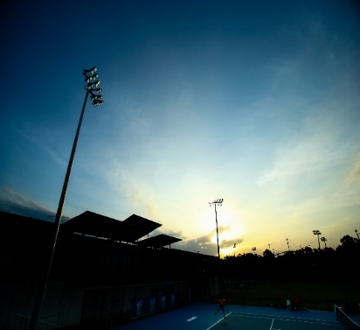
TNSW COMPETITIONS & TOURNAMENTS LANDSCAPE
Tennis Australia, in consultation with each Member Association has made some changes to the 2017 Australian Ranking Tournament Calendar. One of the most significant changes is the move to host the majority of junior tournaments in Australia in the school holidays (only the Nationals, ITF Juniors and School Sport Australia events may be played during the term.)
TNSW supports the move towards tournaments for juniors being hosted primarily during the school holidays, long weekends and public holidays. This approach is aimed at ensuring players maintain a focus on their education whilst still delivering plenty of tournament opportunities throughout the holidays. In conjunction with this move, TNSW is working hard with our clubs to redefine our local club competitions with a sharp focus on providing a strong competitive framework. Our vision is to deliver competition for players of all abilities in order for them to achieve a level of performance that their talent, determination and desire allows. Following extensive research, focus groups and consultancy with a variety of stakeholders including coaches, current and past players, clubs and associations, TNSW will launch the Sydney Tennis League in 2017.

Slide 3
SYDNEY TENNIS LEAGUE
TNSW will launch the Sydney Tennis League in 2017 with a commitment to deliver the following:
Provide a club based league structure that engages players throughout their tennis lifetime
Local competitions within a tiered structure, ensuring players compete locally and at the right level for them
Fun, team based competition and a less pressurised environment in which to compete in
A participation pathway reducing travel and cost which provides competitive matches week in, week out
Link affiliated clubs together is structured Leagues and assist in their administration
Encourage competitors to play at their local clubs
Establish an appropriate standard of rating through the National Rating based on match results
Encourage and assist in getting coaches and parents involved in local leagues

Slide 4
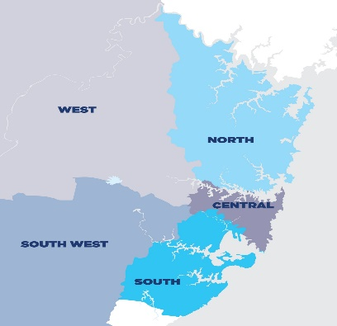
STL REGIONS
Each Tennis NSW Affiliate will be assigned to one of five metropolitan Sydney regions when competing in the Sydney Tennis League
1. SOUTH WEST, 2. NORTH, 3. CENTRAL, 4. SOUTH & 5. WEST

Slide 5
TIERED LEAGUE STRUCTURE
The Sydney Tennis League will comprise of three competitive tiers
TIER ONE_ALL STARS: The highest play standard will require competitions centrally organised in order to bring together players of this standard. These will be centrally organised and administered by TNSW and will set the benchmark for competition in metro Sydney.
TIER TWO_INTER-CLUB: The next level of players are brought together via the five metro regions. These will also be centrally organised and administered by TNSW
TIER THREE_INTRA-CLUB: At the most populous level, competitions will be organised by local associations, clubs and court operators to meet the needs of their local community. TNSW will assist in the promotion, cross-fertilisation of ideas, software, marketing and general support for these competitions

Slide 6
TIER ONE
NSW PREMIER CLUB REPRESENTATIVE LEAGUE
ADULT
Sydney All Stars
Top Representative Clubs in NSW can enter teams to compete for prizemoney and the Sydney All Stars title
The competition will run over approx. 4 – 6 weeks in term 2 and term 3 that will align with the end / start of the pro tour circuit and Platinum/Gold AMT swing
Tier 1 Leagues will be administered and run by TNSW
JUNIOR
Sydney All Stars – 10/U, 12/U, 14/U
Played in terms 1, 2, 3 & 4 over a period of 4 – 6 weeks
Players will be drafted by Sydney Tennis League Committee into teams
This competition will cater to the top level AR tournament Junior players
The purpose of the competition is to provide competitive matches, a team environment, and representation of a metropolitan region

Slide 7
TIER ONE
NSW PREMIER CLUB REPRESENTATIVE LEAGUE
ADULT (2016 Pilot League)
JUNIOR (2017 Pilot League)

Slide 8
TIER TWO
INTER-CLUB REPRESENTATIVE LEAGUE
SYDNEY BADGE
League
Sydney’s established doubles only competition that will run over 7 weeks in term 2 and the second 7 weeks in term 3
131 Metro Clubs in Sydney & 34 competing in Badge – room to grow structured competition tennis as evidenced by participation in other states such as VIC (465 teams and 4,500 players) and WA (996 teams and 8,000 players)
Administered by TNSW
JUNIOR & ADULT
Leagues
Our 2017 goal is to get 6 Clubs within each of the 5 metropolitan regions competing in a single division inter-club competition that is gender based from 10/U Hot Shots Leagues to 12/U & 14/U Junior Leagues and to an Open Adult League
Four seasons to be run per year all aligning within the school terms. The competition will consist of 6-8 match weeks, which will provide players with a great opportunity to represent their clubs but also gain much needed competitive match play

Slide 9
TIER TWO
INTER-CLUB REPRESENTATIVE LEAGUE
SYDNEY BADGE
League
(5 Metro Regions)
JUNIOR & ADULT
Leagues
(5 Metro Regions)

Slide 10
TIER THREE
INTRA-CLUB REPRESENTATIVE LEAGUE
Club hosted competition with support of TNSW
Clubs to host competition open to the Club Members and/or TNSW members
Players can compete at their local centre with minimal travel
TNSW to help with resources required to promote and run the competition
Umbrella support of the Sydney Tennis League brand to drive participation
Entry pathway into competition tennis for all ages

Slide 11
BENEFITS OF STL
The Sydney Tennis League is designed to achieve the following for our TNSW affiliates
Bringing Tournament Players back into Clubs
Effective competition / participation pathway
League Structure
Marketing & Communications Support to grow competition tennis
Tennis Australia League Manager Software – Training & Support
Purpose built website which will allow players to find a STL affiliated Club

Slide 12
FEEDBACK
Any Feedback for the team? Suggestions or improvements?
Email: STL@tennis.com.au
Phone: 02 9024 7737

